Slide 1

Loudoun County Growth Study
By: Andrew Kemp

Slide 2
Purpose of the Study
Analyze Loudoun County's economic characteristics, including employment, business growth, income trends, housing costs, and GDP trends.
Compare Loudoun County to peer counties: Fairfax (VA), Montgomery (MD), Santa Clara (CA), Dallas (TX), Davidson (TN), and Wake (NC).
Provide actionable recommendations to sustain growth and attract economic projects.

Slide 3
Methodology
Data Sources: U.S. Census Bureau, Bureau of Labor Statistics (BLS), Bureau of Economic Analysis (BEA)
Tools and Techniques: Jupyter Notebook, Python, Pandas, NumPy, Matplotlib, Seaborn, Scikit-learn, Statsmodels.
Analysis Techniques: Descriptive statistics, Trend Analysis, Comparative Analysis, Time-series, linear regression, correlation analysis, ARIMA forecasting,

Slide 4
Limitations
Data Gaps: Missing or inconsistent data for certain years.
Assumptions: Forecasting models are based on historical data trends.
Granularity: Industry-specific insights may require additional detailed datasets.

Slide 5
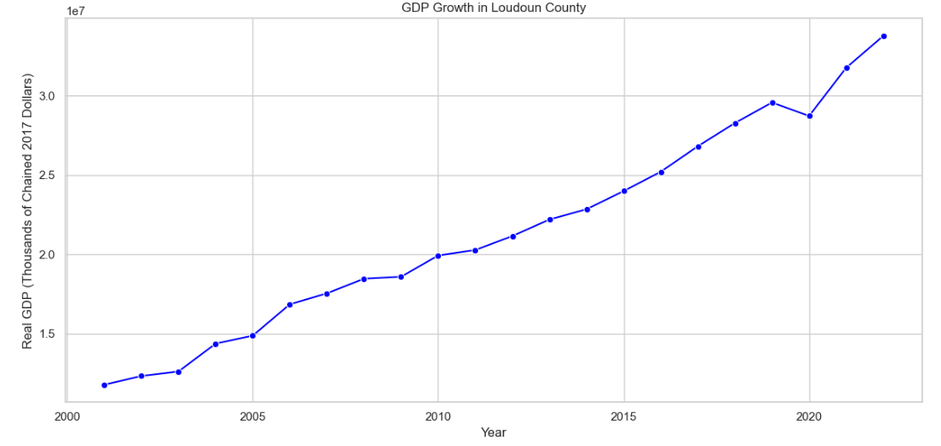
GDP Growth in Loudoun County (2000-2023)
Loudoun County’s GDP grew 186%, from $11.78 billion in 2001 to $33.77 billion in 2023.
The slight GDP decrease in 2020 reflects the economic impact of COVID-19, highlighting vulnerabilities during global disruptions.
Consistent growth reflects the county's expanding economy, driven by high-value industries.

Slide 6
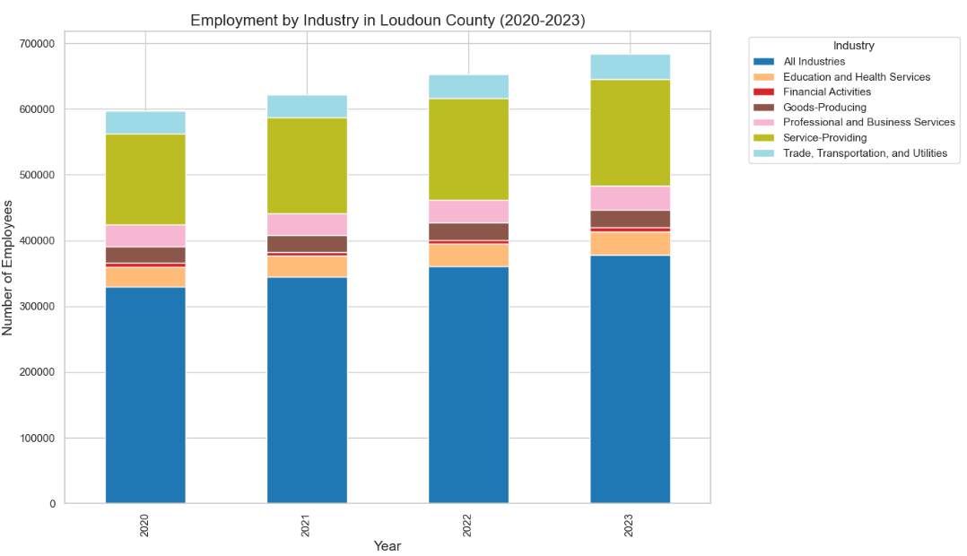
Employment by Industry
Service-Providing Industries dominate, with strong contributions from Education, Health Services, and Professional Services.
Employment increased steadily, reflecting post-pandemic recovery and growth.
Trade, Transportation, and Utilities remained consistent, supporting economic stability.

Slide 7
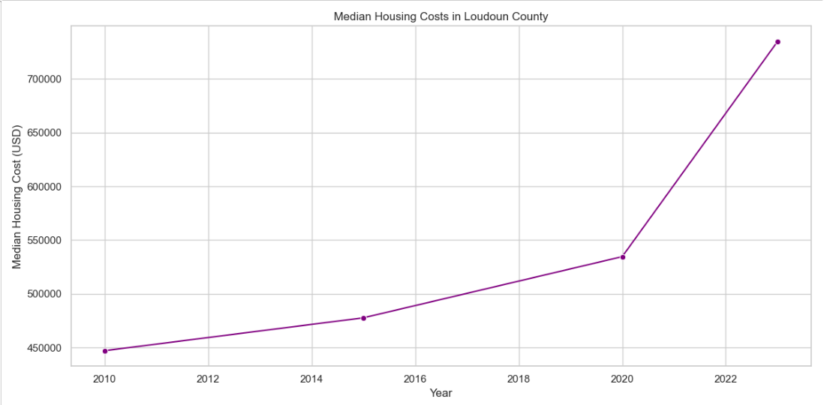
Median Housing Costs in Loudoun County (2010-2023)
Median housing costs rose sharply by 64.3%, from $447,100 in 2010 to $734,700 in 2023.
The increase accelerated post-2020, driven by population growth and limited housing supply.
Rising costs may challenge affordability for middle-income families and workers.

Slide 8
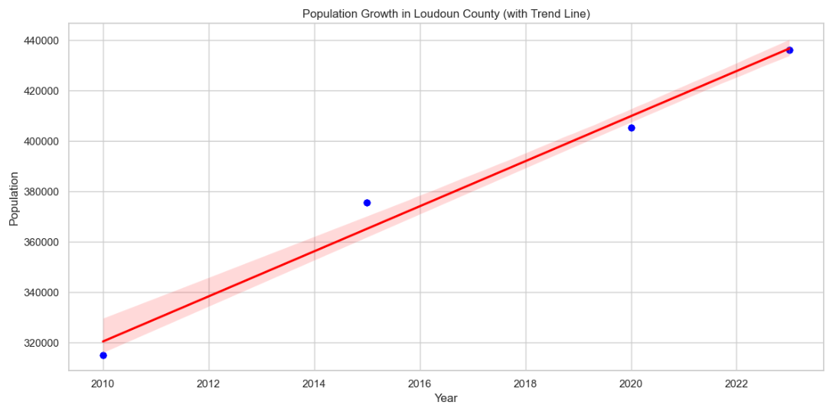
Population Growth in Loudoun County (2010-2023)
Loudoun County’s population grew by 35%, from approximately 322,000 in 2010 to over 435,000 in 2023.
The steady growth trend reflects the county’s attractiveness for residents, driven by economic opportunities and quality of life.
Continued population growth may increase demand for housing, infrastructure, and public services.

Slide 9
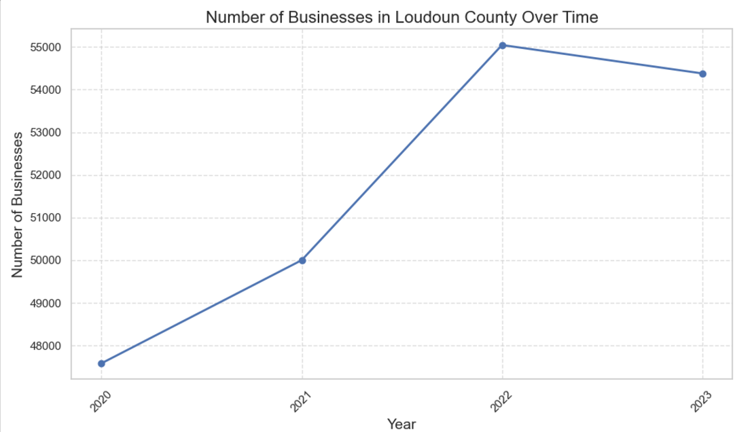
Number of Businesses in Loudoun County Over Time (2020-2023)
Steady Growth: From 2020 to 2022, the number of businesses in Loudoun County showed consistent growth, reflecting economic resilience.
Decline in 2023: A slight decline in the number of businesses from 2022 to 2023 suggests ongoing economic challenges and adjustments post-pandemic.
Implication: This trend underscores the need for policies aimed at fostering business recovery and long-term stability.

Slide 10
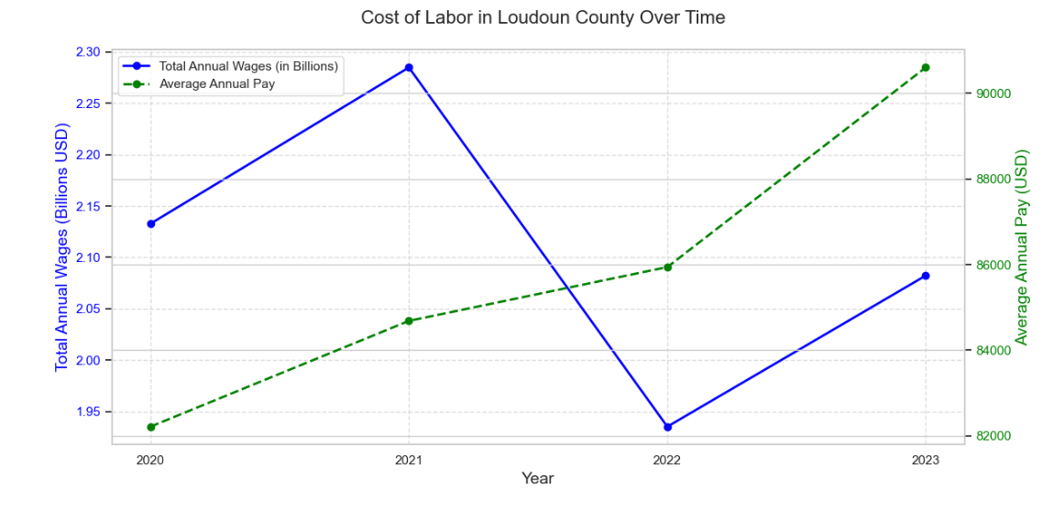
Cost of Labor in Loudoun County Over Time
Total annual wages peaked in 2021 at $2.3 billion but experienced a sharp decline in 2022 before recovering in 2023.
Average annual pay steadily increased from $85,000 in 2020 to over $90,000 in 2023.
The divergence between total wages and average pay suggests workforce reductions or shifts in employment distribution.

Slide 11
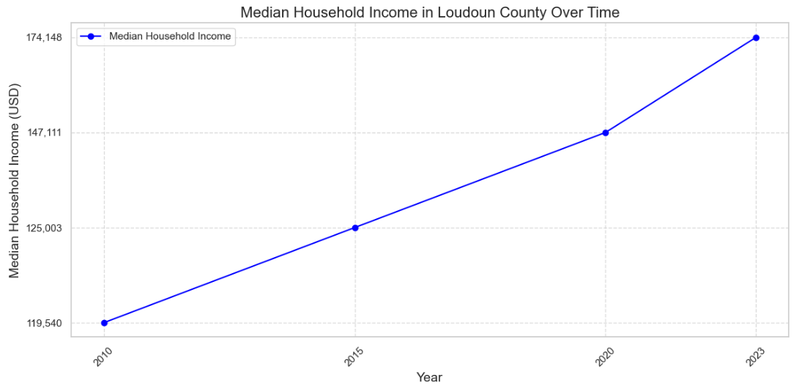
Median Household Income in Loudoun County Over Time
Median household income has shown consistent growth, increasing from $119,540 in 2010 to $174,148 in 2023.
The steady rise reflects Loudoun County's robust economic development and high standard of living.
Loudoun County's income levels are significantly above national averages, highlighting its position as a highly affluent region.

Slide 12
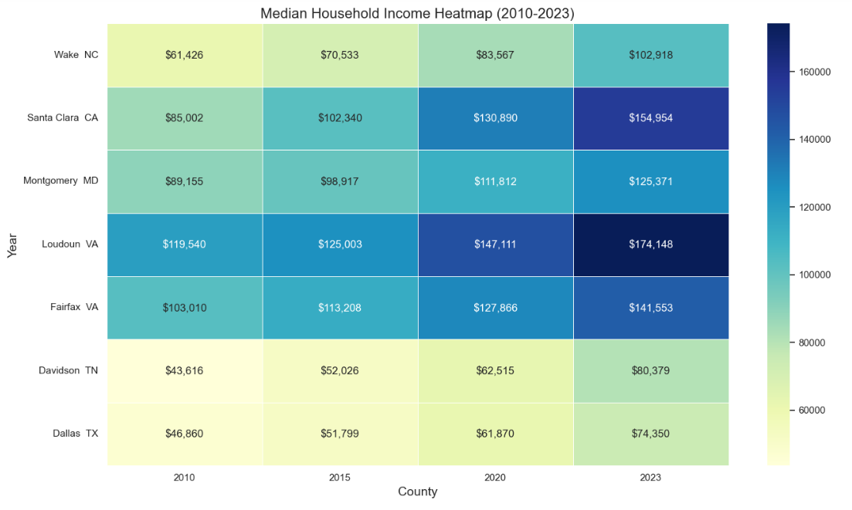
Median Household Income by County (2010-2023)
Loudoun County consistently leads in median household income, rising from $119,540 in 2010 to $174,148 in 2023, reflecting strong economic growth and affluence.
Santa Clara County, CA, and Fairfax County, VA, rank second and third in income levels, showcasing competitive living standards in tech and government hubs.
Counties such as Davidson, TN, and Dallas, TX, display steady growth but remain below the income levels of Loudoun and its peers, reflecting varied economic bases.

Slide 13
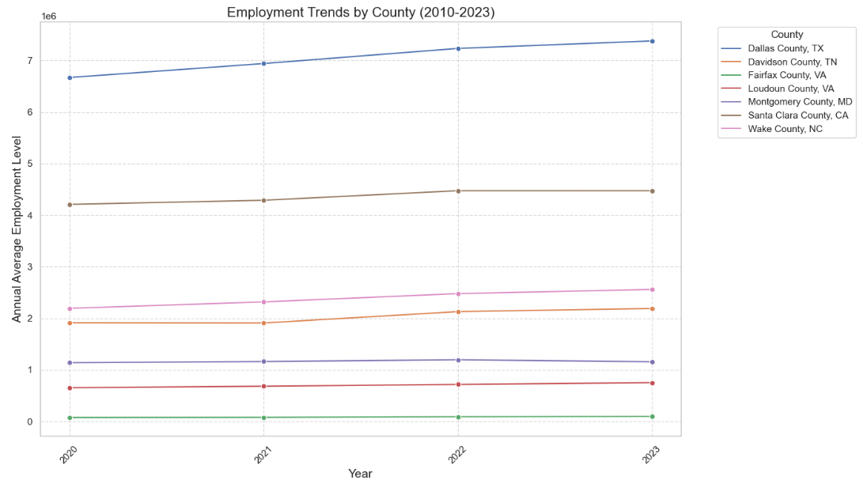
Employment Trends by County (2010-2023)
Dallas County, TX leads in annual average employment levels, reflecting its large metropolitan workforce and diverse economic base.
Loudoun County, VA, shows steady growth, driven by its expanding tech and service industries, while still trailing behind larger counties like Dallas and Santa Clara.
Employment levels across counties exhibit consistent growth trends, highlighting economic resilience and sectoral diversification.

Slide 14
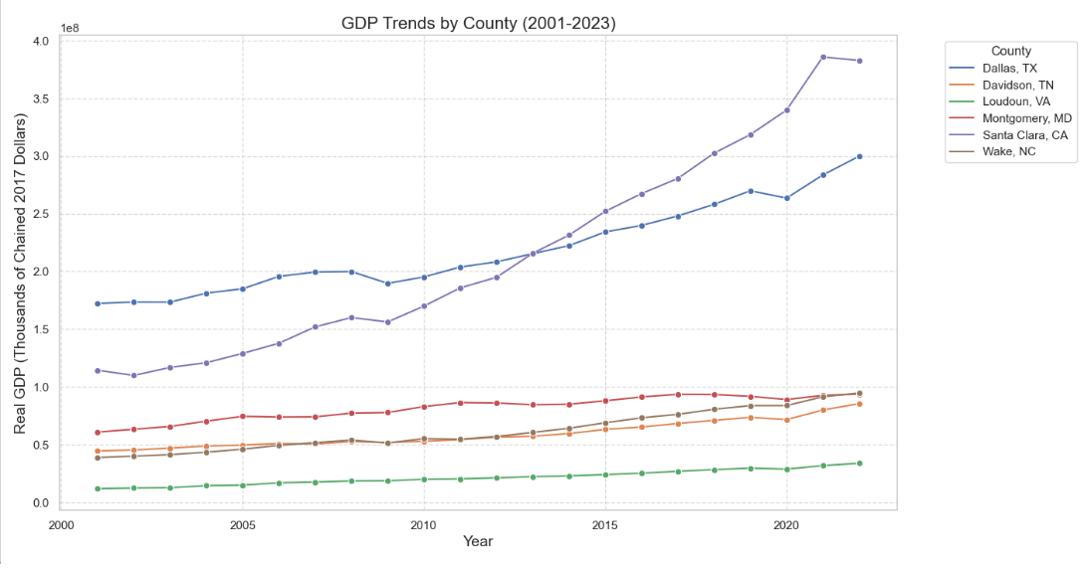
GDP Trends by County (2001-2023)
Santa Clara County, CA, demonstrates the most substantial growth, reflecting its leadership in the tech-driven economy of Silicon Valley.
Dallas County, TX, follows as a strong economic hub with consistent GDP increases, showcasing a diverse and resilient economy.
Loudoun County, VA, while smaller in scale, shows steady growth, indicating its emerging role as a tech and services powerhouse.

Slide 15
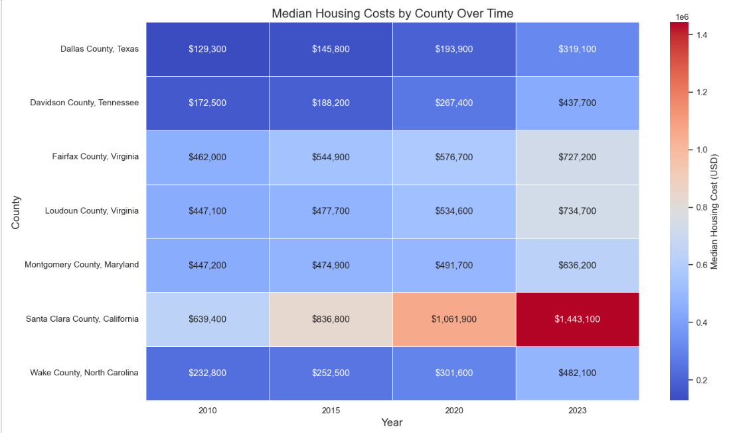
Median Housing Costs by County Over Time
Santa Clara County, CA, leads in housing costs, with a significant increase from $639,400 in 2010 to $1,443,100 in 2023, reflecting its strong tech industry and housing demand.
Loudoun County, VA, saw a steady rise, reaching $734,700 in 2023, demonstrating the area's growing affluence and desirability.
Davidson County, TN, and Dallas County, TX, experienced more moderate but consistent growth, indicative of affordable housing markets relative to other counties.

